Slide 1
A sort of Adversary Haim Kaplan ・ Or Zamir ・ Uri Zwick
2023/7/24 Department of Information on Physics & Computing
Sungying Chiang

Slide 2
Outline
Prior Knowledge
Developing The Adversary
Summary
Upper bound & Lower bound on number of comparisons
Partial orders & Linear Extensions
Adversaries
Past work on this topic
New Adversary Proposing
A lot of graphs
A lot of math magic
Reason we CANNOT generalize
Future improvement possibilities

Slide 3
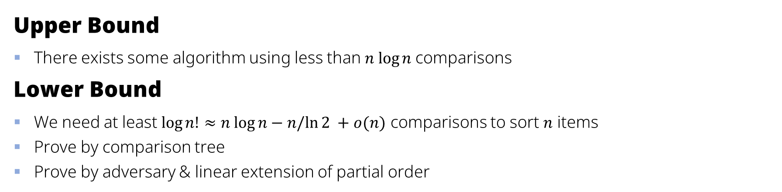
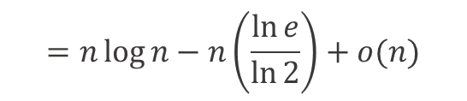
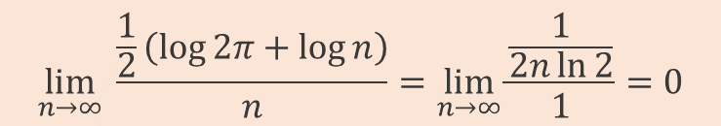

Bounds on Number of Comparisons
Upper Bound
There exists some algorithm using less than $n log⁡n$comparisons
Lower Bound
We need at least $log⁡n!≈n log⁡n−n/ln⁡2 +o(n)$ comparisons to sort 𝑛 items
Prove by comparison tree
Prove by adversary & linear extension of partial order
$$\log{n!}≈\log\left[\sqrt{2πn}∙{\left(\frac{n}{e}\right)}^{n}\right]=\log{\sqrt{2πn}}+n\log{\frac{n}{e}}=\frac{1}{2}\left(\log{2π}+\log{n}\right)+n\left(\log{n−\log{e}}\right)$$
$$=n\log{n}−n\left(\frac{\ln{e}}{\ln{2}}\right)+\frac{1}{2}\left(\log{2π}+\log{n}\right)$$
$$=n\log{n}−n\left(\frac{\ln{e}}{\ln{2}}\right)+o(n)$$
$$\lim_{n→∞} \frac{\frac{1}{2}\left(\log{2π}+\log{n}\right)}{n}=\lim_{n→∞}{\frac{\frac{1}{2n\ln{2}}}{1}}=0$$

Slide 4




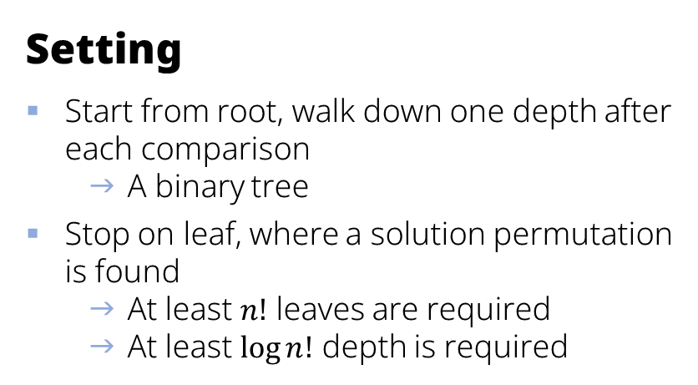
Prove the Lower Bound — Comparison Tree
Setting
Start from root, walk down one depth after each comparison
A binary tree
Stop on leaf, where a solution permutation is found
At least $n!$ leaves are required
At least $log⁡n!$ depth is required
<
<
<
<
<
2
1
3
$$R→L$$
3
2
1
$$R→R→R$$

Slide 5
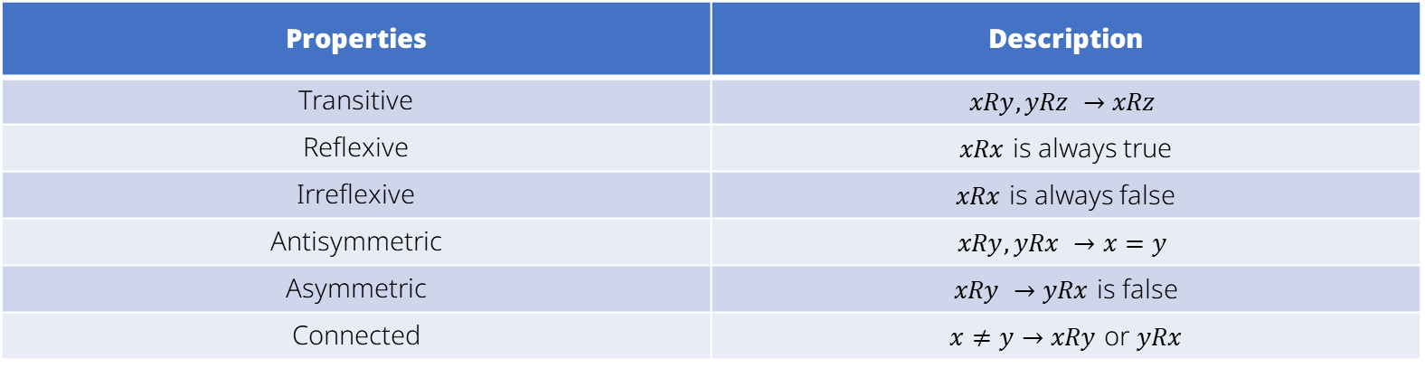
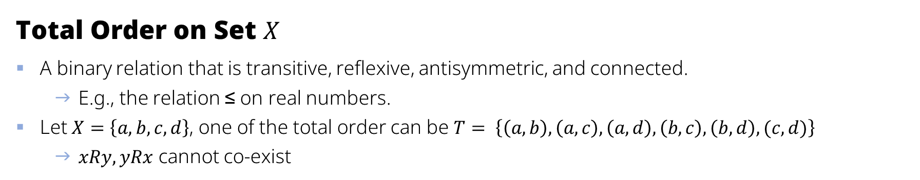
Total Order, Partial Order & Linear Extension①
Total Order on Set $X$
A binary relation that is transitive, reflexive, antisymmetric, and connected.
E.g., the relation ≤ on real numbers.
Let $X=\left\{a, b, c, d\right\}$, one of the total order can be $T= \left\{\left(a, b\right), \left(a, c\right), \left(a, d\right), \left(b, c\right), \left(b, d\right), (c, d)\right\}$
$xRy, yRx$ cannot co-exist
Properties | Description
Transitive | $$xRy,yRz →xRz$$
Reflexive | $xRx$ is always true
Irreflexive | $xRx$ is always false
Antisymmetric | $$xRy, yRx →x=y$$
Asymmetric | $xRy →yRx$ is false
Connected | $x≠y→xRy$ or $yRx$

Slide 6
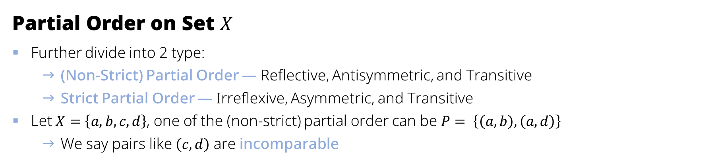
Total Order, Partial Order & Linear Extension②
Partial Order on Set $X$
Further divide into 2 type:
(Non-Strict) Partial Order — Reflective, Antisymmetric, and Transitive
Strict Partial Order — Irreflexive, Asymmetric, and Transitive
Let $X=\left\{a, b, c, d\right\}$, one of the (non-strict) partial order can be $P= \left\{\left(a, b\right), \left(a, d\right)\right\}$
We say pairs like $\left(c, d\right)$ are incomparable
Properties | Description
Transitive | $$xRy,yRz →xRz$$
Reflexive | $xRx$ is always true
Irreflexive | $xRx$ is always false
Antisymmetric | $$xRy, yRx →x=y$$
Asymmetric | $xRy →yRx$ is false
Connected | $x≠y→xRy$ or $yRx$

Slide 7
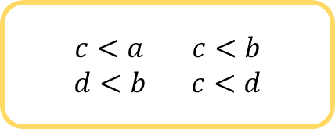

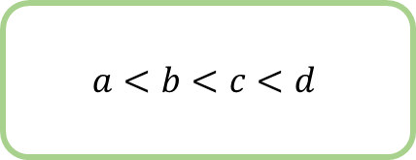
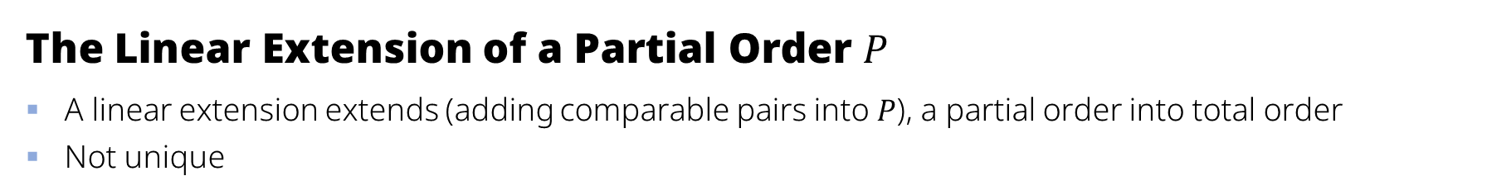
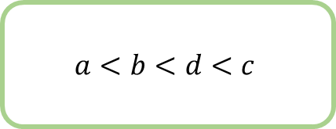
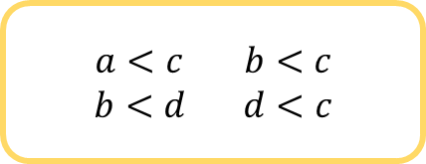

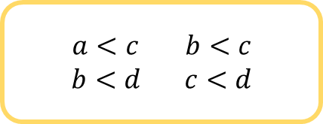
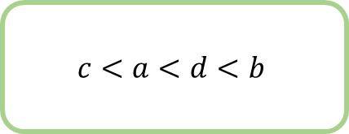
Total Order, Partial Order & Linear Extension③
The Linear Extension of a Partial Order $P$
A linear extension extends (adding comparable pairs into $P$), a partial order into total order
Not unique
$a<c$ $b<c$
$b<d$ $d<c$
$$a<b<d<c$$
$$a<b$$
$$a<d$$
U
$a<c$ $b<c$
$b<d$ $c<d$
=
$$a<b<c<d$$
$c<a$ $c<b$
$d<b$ $c<d$
$$c<a<d<b$$
$$⋮$$

Slide 8
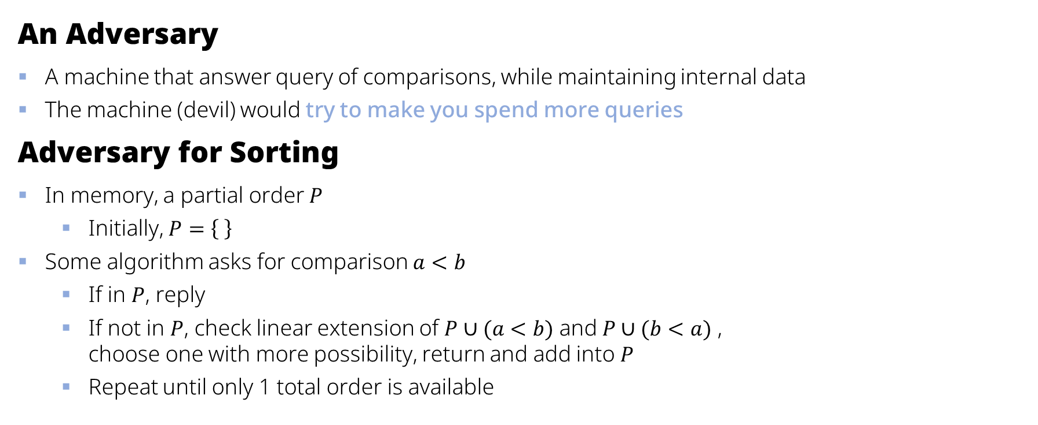
Prove the Lower Bound — Adversary①
An Adversary
A machine that answer query of comparisons, while maintaining internal data
The machine (devil) would try to make you spend more queries
Adversary for Sorting
In memory, a partial order $P$
Initially, $P=\left\{ \right\}$
Some algorithm asks for comparison $a<b$
If in $P$, reply
If not in $P$, check linear extension of $P∪(a<b)$ and $P∪(b<a)$ , choose one with more possibility, return and add into $P$
Repeat until only 1 total order is available

Slide 9


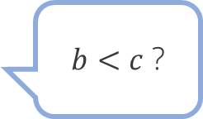
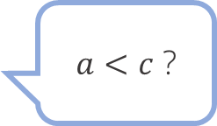
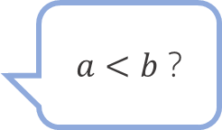
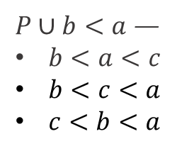


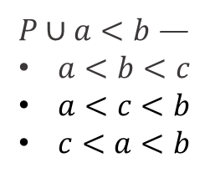





Prove the Lower Bound — Adversary②
$$P=\left\{ \right\}$$
$P∪a<b$ —
$a<b<c$
$a<c<b$
$c<a<b$
$P∪b<a$ —
$b<a<c$
$b<c<a$
$c<b<a$
$a<b$ ?
〇
$$P=\left\{(a, b)\right\}$$
$P∪b<c$ —
$a<b<c$
$P∪c<b$ —
$a<c<b$
$c<a<b$
$b<c$ ?
×
$$P=\left\{\left(a, b\right), (c,b)\right\}$$
$P∪a<c$ —
$a<b<c$
$P∪c<a$ —
$c<a<b$
$a<c$ ?
〇

Slide 10
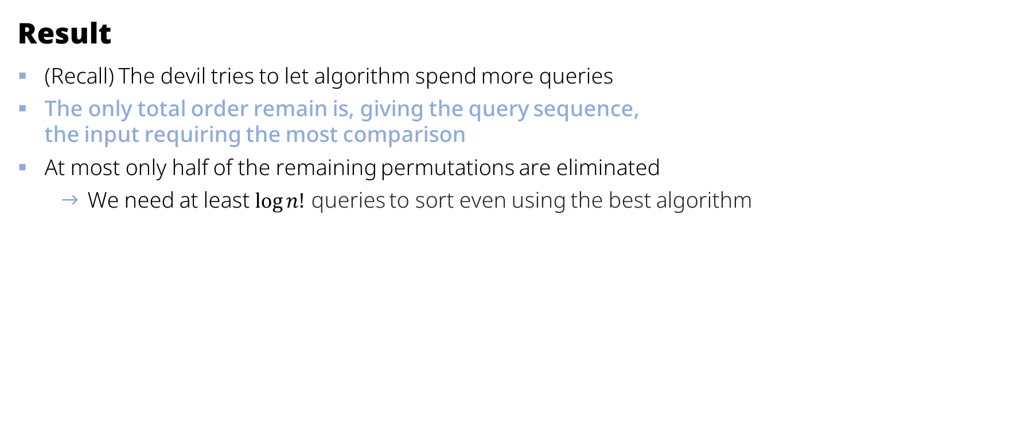
Prove the Lower Bound — Adversary③
Result
(Recall) The devil tries to let algorithm spend more queries
The only total order remain is, giving the query sequence, the input requiring the most comparison
At most only half of the remaining permutations are eliminated
We need at least $\log{n!}$ queries to sort even using the best algorithm

Slide 11

Sorting Adversary Problem
Not Efficient
Counting linear expansion is #P-complete, No polynomial algorithm unless P = NP
Guessing
Approximating with lower bound $\left(1−ε\right)\log{n!}$ with some small $ε$
But…
Also, no known deterministic approximate algorithm for it
We must work with FPRAS (Fully Polynomial Randomized Approximation Scheme)

Slide 12
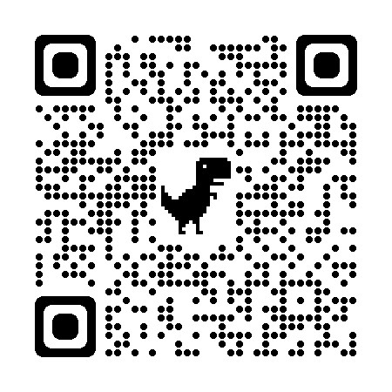
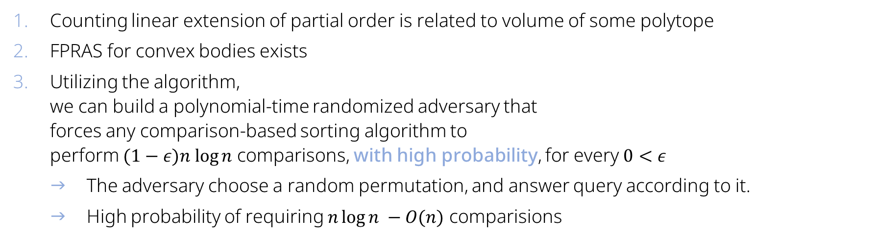
FPRAS Algorithm For Counting Extensions
Counting linear extension of partial order is related to volume of some polytope
FPRAS for convex bodies exists
Utilizing the algorithm, we can build a polynomial-time randomized adversary that forces any comparison-based sorting algorithm to perform $(1−ε)n log⁡n$ comparisons, with high probability, for every $0<ε$
The adversary choose a random permutation, and answer query according to it.
High probability of requiring $n\log{n} −O(n)$ comparisions
The problem is described in the paper:
Counting Linear Extensions, Brightwell, G., Winkler, P. Counting linear extensions. Order 8, 225–242 (1991). https://link.springer.com/article/10.1007/bf00383444

Slide 13
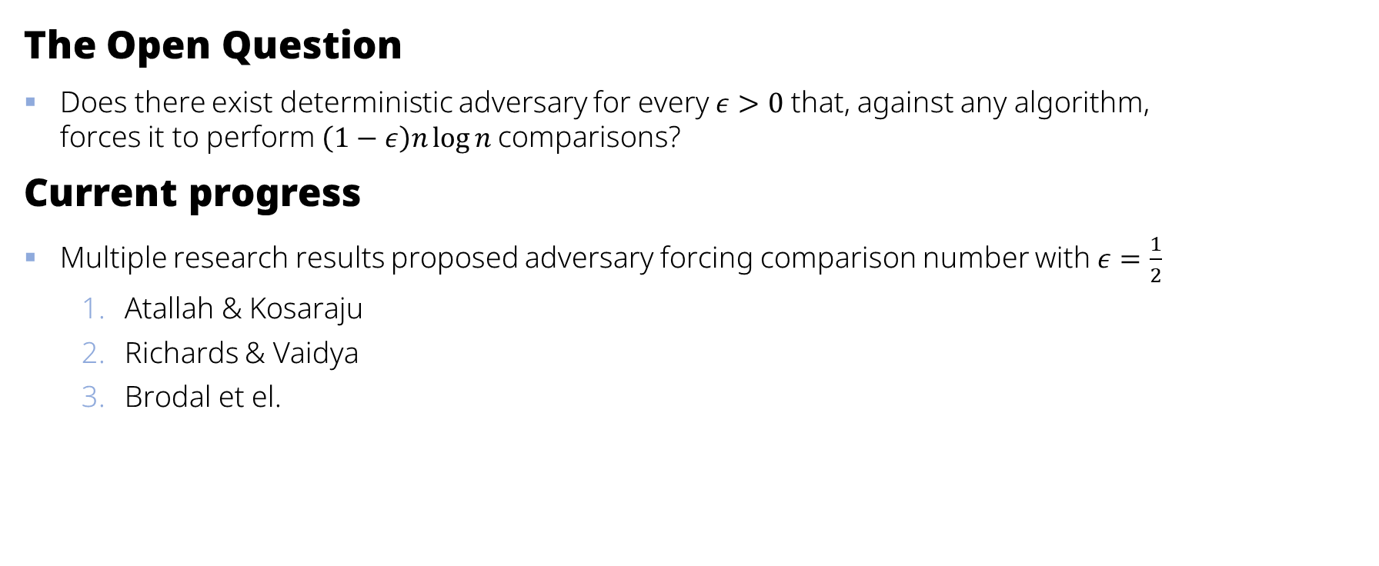
Deterministic Adversary
The Open Question
Does there exist deterministic adversary for every $ε>0$ that, against any algorithm, forces it to perform $\left(1−ε\right)n\log{n }$comparisons?
Current progress
Multiple research results proposed adversary forcing comparison number with $ε=\frac{1}{2}$
Atallah & Kosaraju
Richards & Vaidya
Brodal et el.
refinement

Slide 14
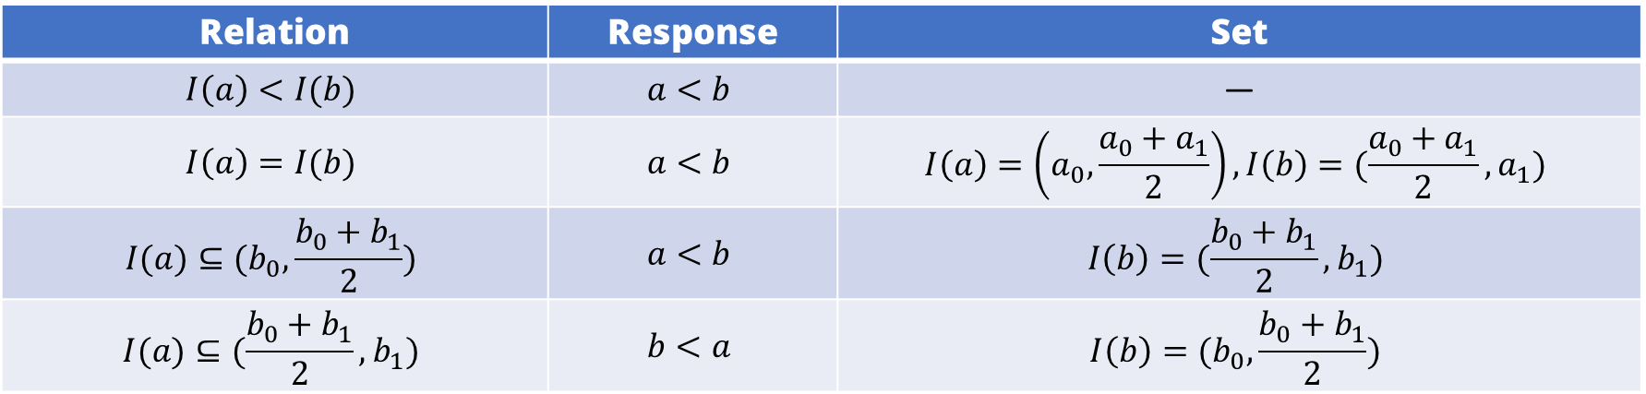

Deterministic Adversary by Brodal et el.
The Adversary
For all input items $a$, a interval $I(α)$ is kept; Initially, all $I\left(α\right)=(0, 1)$
$I\left(α\right)=(\frac{j}{2^{i}},\frac{j+1}{2^{i}})$, for integer $i≥0$ and $0≤j<2^{i}$
The adversary answers comparison according to relation of intervals, given $\left\{\begin{matrix}I\left(a\right)=(a_{1},a_{2}) \\ I\left(b\right)=(b_{1},b_{2})\end{matrix}\right.$
Symmetric cases are handled symmetrically (?)
Relation | Response | Set
$$I\left(a\right)<I(b)$$ | $$a<b$$ | —
$$I\left(a\right)=I(b)$$ | $$a<b$$ | $$I\left(a\right)=\left(a_{0},\frac{a_{0}+a_{1}}{2}\right),I\left(b\right)=(\frac{a_{0}+a_{1}}{2},a_{1})$$
$$I(a)⊆(b_{0},\frac{b_{0}+b_{1}}{2})$$ | $$a<b$$ | $$I\left(b\right)=(\frac{b_{0}+b_{1}}{2},b_{1})$$
$$I(a)⊆(\frac{b_{0}+b_{1}}{2},b_{1})$$ | $$b<a$$ | $$I\left(b\right)=(b_{0},\frac{b_{0}+b_{1}}{2})$$

Slide 15
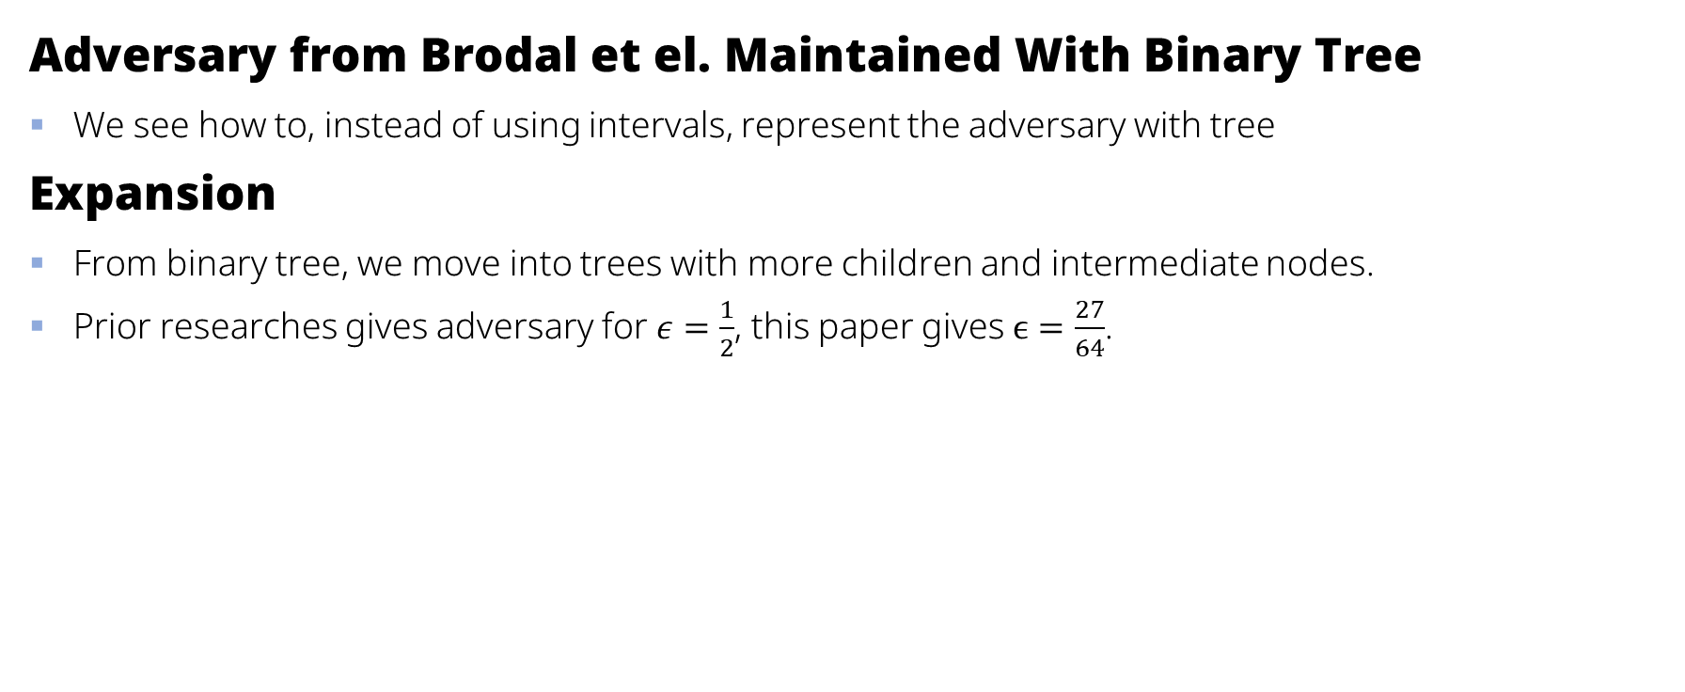
What to expect in the research paper
Adversary from Brodal et el. Maintained With Binary Tree
We see how to, instead of using intervals, represent the adversary with tree
Expansion
From binary tree, we move into trees with more children and intermediate nodes.
Prior researches gives adversary for $ε=\frac{1}{2}$, this paper gives $ϵ=\frac{27}{64}$.

Slide 16



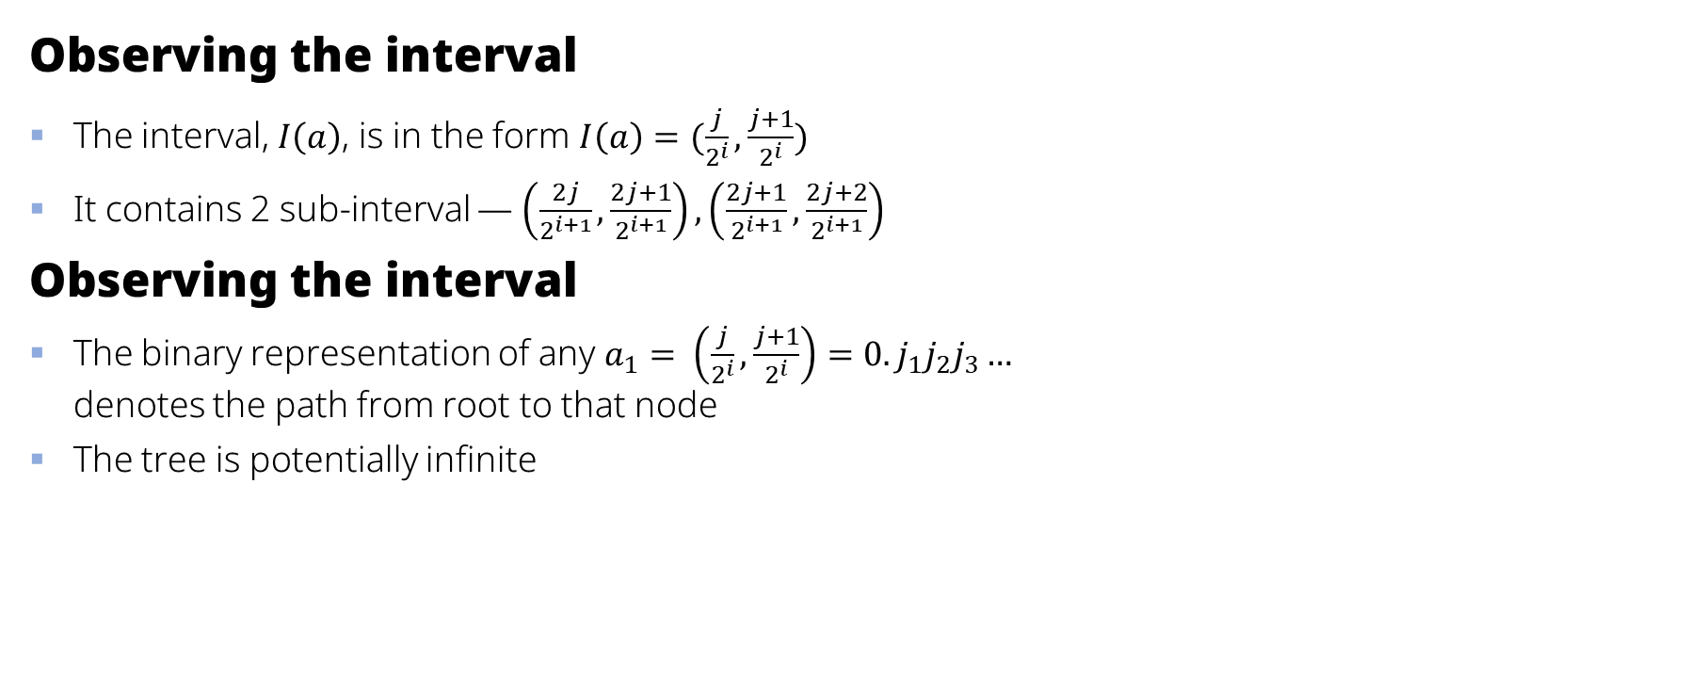




Transforming Into Tree adversary
Observing the interval
The interval, $I\left(a\right)$, is in the form $I\left(a\right)=(\frac{j}{2^{i}},\frac{j+1}{2^{i}})$
It contains 2 sub-interval — $\left(\frac{2j}{2^{i+1}},\frac{2j+1}{2^{i+1}}\right),\left(\frac{2j+1}{2^{i+1}},\frac{2j+2}{2^{i+1}}\right)$
Observing the interval
The binary representation of any $a_{1}= \left(\frac{j}{2^{i}},\frac{j+1}{2^{i}}\right)=0.j_{1}j_{2}j_{3}…$ denotes the path from root to that node
The tree is potentially infinite
$$(0, 1)$$
$$(0.0, 0.1)$$
$$(0.1, 1.0)$$
$$(0.00, 0.01)$$
$$(0.01, 0.10)$$
$$(0.10, 0.11)$$
$$(0.11, 1.00)$$

Slide 17

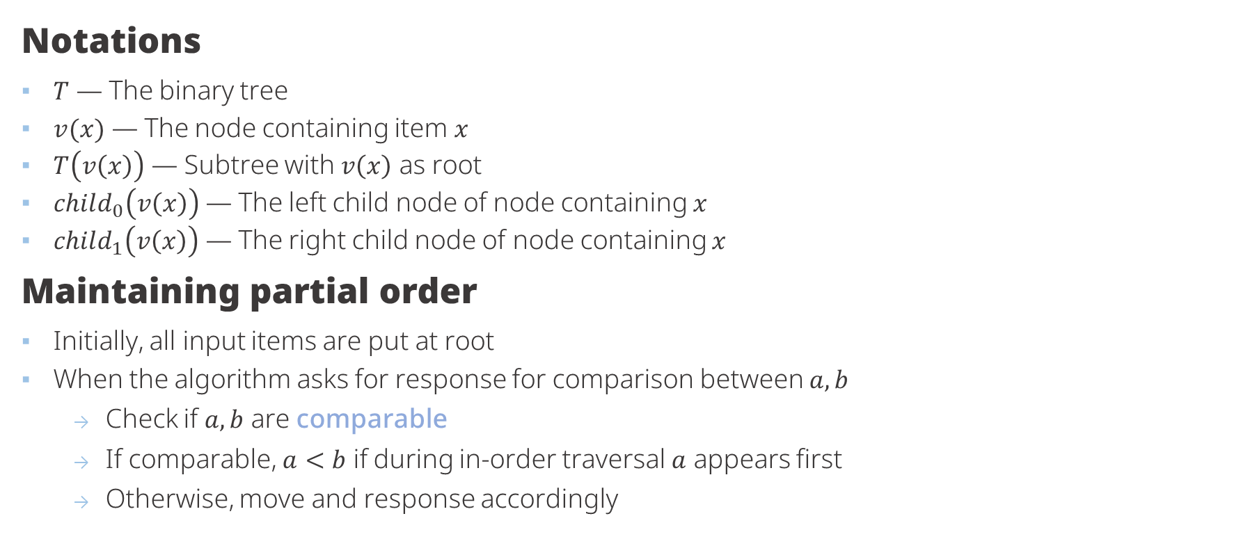
Operating With Adversary Tree①
Notations
$T$ — The binary tree
$v(x)$ — The node containing item $x$
$T\left(v\left(x\right)\right)$ — Subtree with $v\left(x\right)$ as root
$child_{0}\left(v\left(x\right)\right)$ — The left child node of node containing $x$
$child_{1}\left(v\left(x\right)\right)$ — The right child node of node containing $x$
Maintaining partial order
Initially, all input items are put at root
When the algorithm asks for response for comparison between $a, b$
Check if $a, b$ are comparable
If comparable, $a<b$ if during in-order traversal $a$ appears first
Otherwise, move and response accordingly
$$x$$
1
2
3
4
5
6
7
The in-place traversal —
4 2 5 1 6 3 7

Slide 18
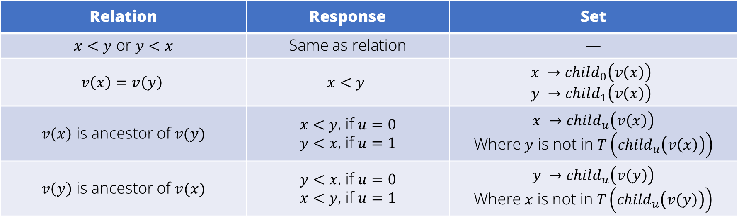
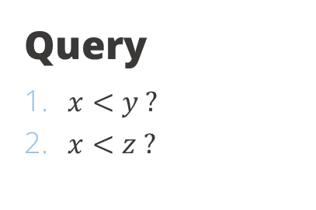



Operating With Adversary Tree②
Incomparable items
Where $v\left(x\right)=v(y)$
Where $v\left(x\right)$ is a ancestor of $v(t)$, or vise versa
Query
​$x<y ?$
​$x<z ?$
$$y$$
$$x$$
$$z$$
Relation | Response | Set
$x<y$ or $y<x$ | Same as relation | —
$$v\left(x\right)=v\left(y\right)$$ | $$x<y$$ | $$x →child_{0}\left(v\left(x\right)\right) \\ y →child_{1}\left(v\left(x\right)\right)$$
$v\left(x\right)$ is ancestor of $v(y)$ | $x<y$, if $u=0$ $y<x$, if $u=1$ | $$x →child_{u}\left(v\left(x\right)\right)$$ Where $y$ is not in $T\left(child_{u}\left(v\left(x\right)\right)\right)$
$v\left(y\right)$ is ancestor of $v(x)$ | $y<x$, if $u=0$ $x<y$, if $u=1$ | $$y →child_{u}\left(v\left(y\right)\right)$$ Where $x$ is not in $T\left(child_{u}\left(v\left(y\right)\right)\right)$

Slide 19


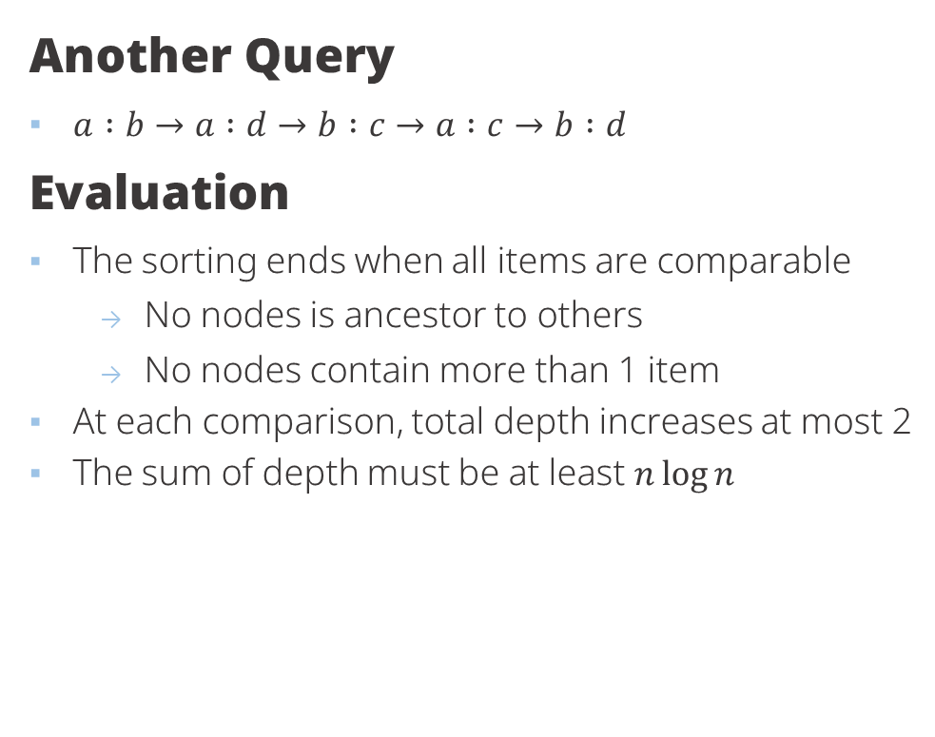



Operating With Adversary Tree③
Another Query
$a :b→a :d→b :c→a :c→b :d$
Evaluation
The sorting ends when all items are comparable
No nodes is ancestor to others
No nodes contain more than 1 item
At each comparison, total depth increases at most 2
The sum of depth must be at least $n\log{n}$
$$a$$
$$b$$
$$c$$
$$d$$
We need at least $\frac{n\log{n}}{2}$ comparisons to sort

Slide 20




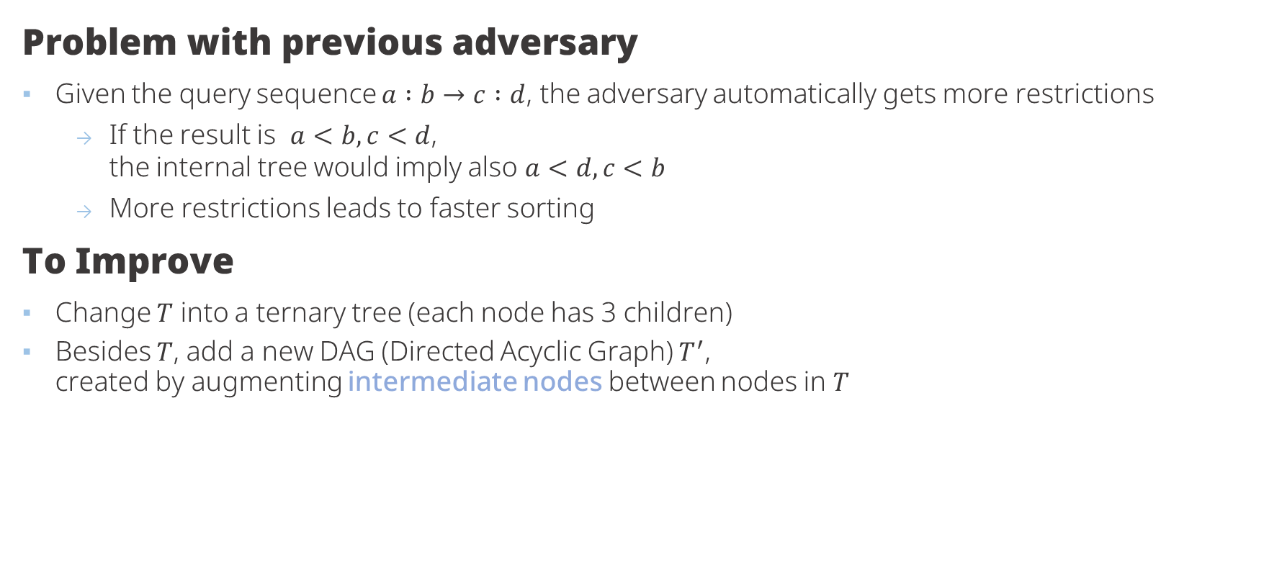






Improving The Adversary
Problem with previous adversary
Given the query sequence $a :b→c :d$, the adversary automatically gets more restrictions
If the result is $a<b, c<d$, the internal tree would imply also $a<d, c<b$
More restrictions leads to faster sorting
To Improve
Change $T$ into a ternary tree (each node has 3 children)
Besides $T$, add a new DAG (Directed Acyclic Graph) $T^{′}$, created by augmenting intermediate nodes between nodes in $T$
$$a$$
$$b$$
$$c$$
$$d$$
$$a$$
$$c$$
$$b$$
$$d$$
$$T$$
$$T^{′}$$

Slide 21




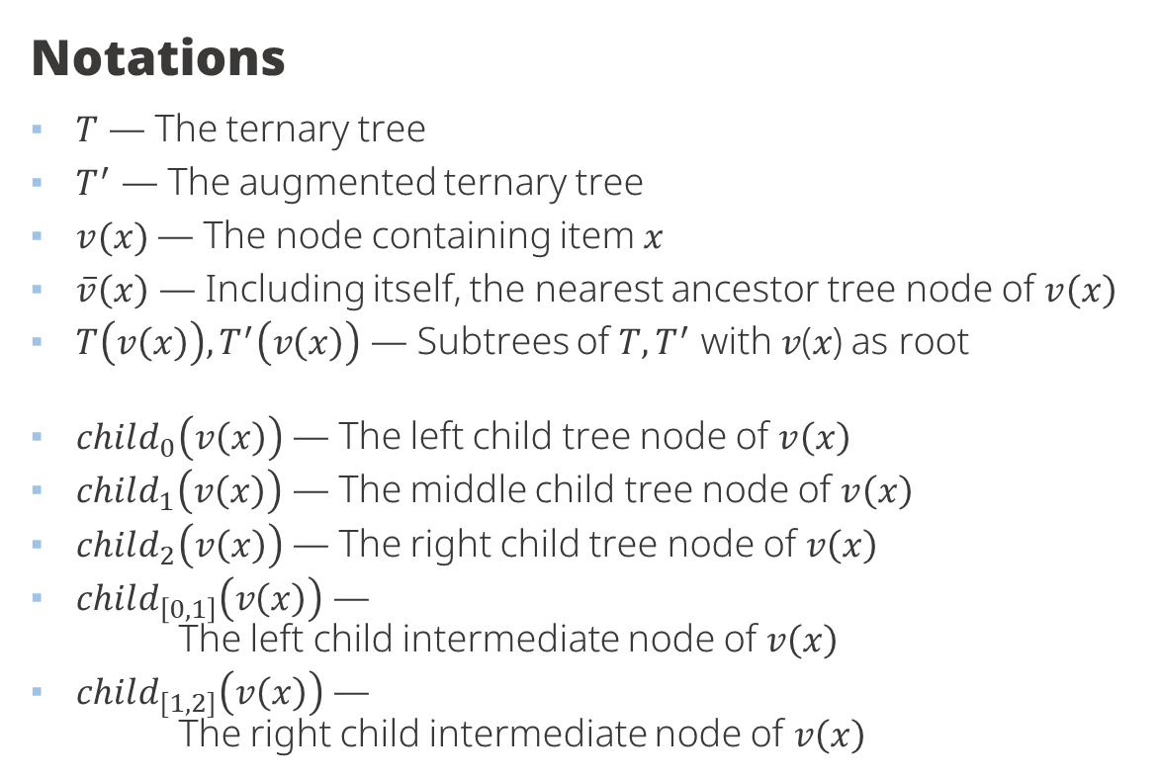






The Ternary Tree Adversary
Notations
$T$ — The ternary tree
$T^{′}$ — The augmented ternary tree
$v(x)$— The node containing item $x$
$\overline{v}\left(x\right)$ — Including itself, the nearest ancestor tree node of $v\left(x\right)$
$T\left(v\left(x\right)\right), T^{′}\left(v\left(x\right)\right)$ — Subtrees of $T, T^{′}$ with 𝑣(𝑥) as root
$child_{0}\left(v\left(x\right)\right)$ — The left child tree node of $v\left(x\right)$
$child_{1}\left(v\left(x\right)\right)$ — The middle child tree node of $v\left(x\right)$
$child_{2}\left(v\left(x\right)\right)$ — The right child tree node of $v\left(x\right)$
$child_{\left[0,1\right]}\left(v\left(x\right)\right)$ — The left child intermediate node of $v\left(x\right)$
$child_{[1,2]}\left(v\left(x\right)\right)$ — The right child intermediate node of $v\left(x\right)$
$$\overline{v}\left(y\right)$$
$$x$$
$$v(x)$$
$$y$$
$$v\left(y\right)$$
$$child_{\left[0,1\right]}\left(v\left(x\right)\right)$$
$$child_{\left[1,2\right]}\left(v\left(x\right)\right)$$
$$child_{0}\left(v\left(x\right)\right)$$
$$child_{1}\left(v\left(x\right)\right)$$
$$child_{2}\left(v\left(x\right)\right)$$

Slide 22

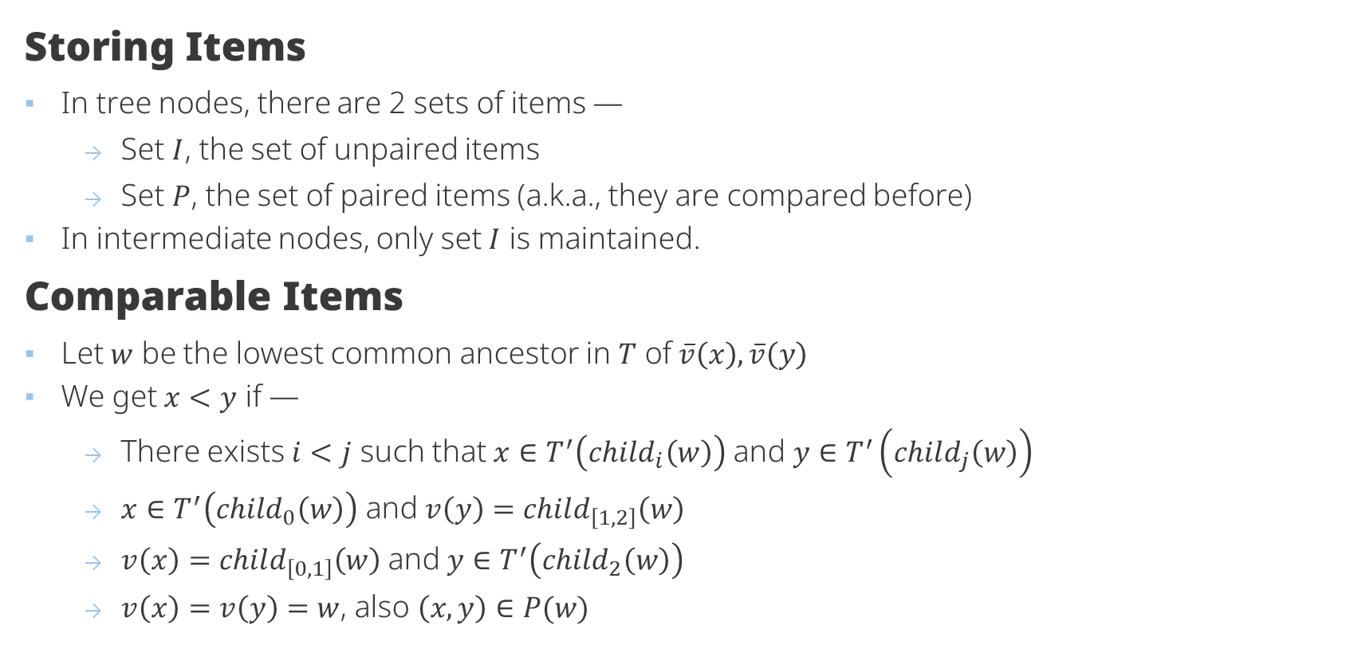

Items In Ternary Tree
Storing Items
In tree nodes, there are 2 sets of items —
Set $I$, the set of unpaired items
Set $P$, the set of paired items (a.k.a., they are compared before)
In intermediate nodes, only set $I$ is maintained.
Comparable Items
Let $w$ be the lowest common ancestor in $T$ of $\overline{v}\left(x\right),\overline{v}\left(y\right)$
We get $x<y$ if —
There exists $i<j$ such that $x∈T^{′}\left(child_{i}\left(w\right)\right)$ and $y∈T^{′}\left(child_{j}\left(w\right)\right)$
$x∈T^{′}\left(child_{0}\left(w\right)\right)$ and $v\left(y\right)=child_{\left[1, 2\right]}\left(w\right)$
$v\left(x\right)=child_{\left[0, 1\right]}\left(w\right)$ and $y∈T^{′}\left(child_{2}\left(w\right)\right)$
$v\left(x\right)=v\left(y\right)=w$, also $\left(x, y\right)∈P(w)$
$$x$$
$$y$$

Slide 23

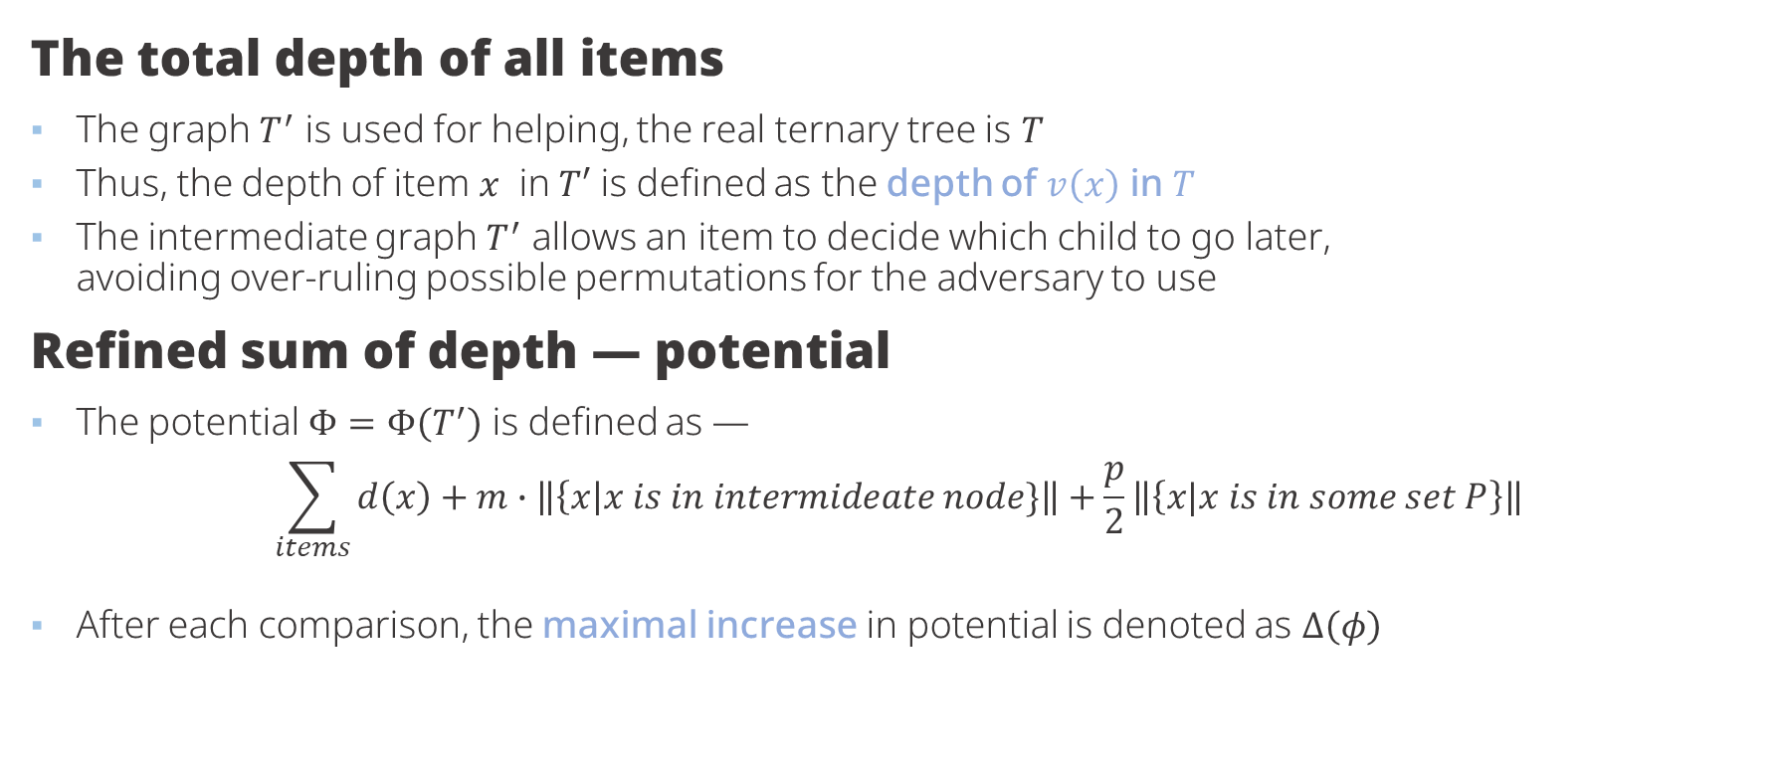
Computing Total Depth & Potential
The total depth of all items
The graph $T^{′}$ is used for helping, the real ternary tree is $T$
Thus, the depth of item $x$ in $T′$ is defined as the depth of $v\left(x\right)$ in $T$
The intermediate graph $T^{′}$ allows an item to decide which child to go later, avoiding over-ruling possible permutations for the adversary to use
Refined sum of depth — potential
The potential $Φ=Φ\left(T^{′}\right)$ is defined as —
$$\sum_{items}{d\left(x\right)}+m∙\left\|\left\{x\right|x is in intermideate node\}\right\|+\frac{p}{2}\left\|\left\{x|x is in some set P\right\}\right\|$$
After each comparison, the maximal increase in potential is denoted as $∆\left(φ\right)$
The sum of potential when sorted is $n\log_{3}{n}$,
Thus we need at least $\frac{1}{Δ\left(φ\right)\log{3}}n\log{n}$ comparisons to sort

Slide 24

Dealing With Incomparable Items①
$$ΔΦ=m$$
A
A
B
B

Slide 25

Dealing With Incomparable Items②
$$ΔΦ=1$$
A
B
A
B

Slide 26
Dealing With Incomparable Items③
$$ΔΦ=1$$
A
B
B
A

Slide 27

Dealing With Incomparable Items④
$$ΔΦ=2−2m$$
A
B
A
B

Slide 28

Dealing With Incomparable Items⑤
$$ΔΦ=1−m$$
A
B
A
B

Slide 29

Dealing With Incomparable Items⑥
$$ΔΦ=p$$
A
B
A
B

Slide 30

Dealing With Incomparable Items⑦
B
C
$$ΔΦ=2−p$$
Compare A : B
A
A
B
C

Slide 31

Dealing With Incomparable Items⑧
A
C
$$ΔΦ=1+m−p$$
Compare A : B
C
B
A
B

Slide 32
Dealing With Incomparable Items⑨
A
B
$$ΔΦ=1+m−p$$
Compare A : C
B
C
A
C

Slide 33
Dealing With Incomparable Items⑩
A
B
$$ΔΦ=1+m−p$$
Compare A : C
C
B
C
A

Slide 34
Dealing With Incomparable Items⑪
A
B
$$ΔΦ=2−p$$
Compare A : C
C
B
A
C

Slide 35

Dealing With Incomparable Items⑫
A
B
$$ΔΦ=1+2m−p$$
C
Compare A : C
B
C
A

Slide 36

Dealing With Incomparable Items⑬
A
B
$$ΔΦ=3+m−2p$$
C
D
Compare A : D
B
A
C
D

Slide 37
Dealing With Incomparable Items⑭
A
B
$$ΔΦ=3+m−2p$$
C
D
Compare A : C
B
A
C
D

Slide 38
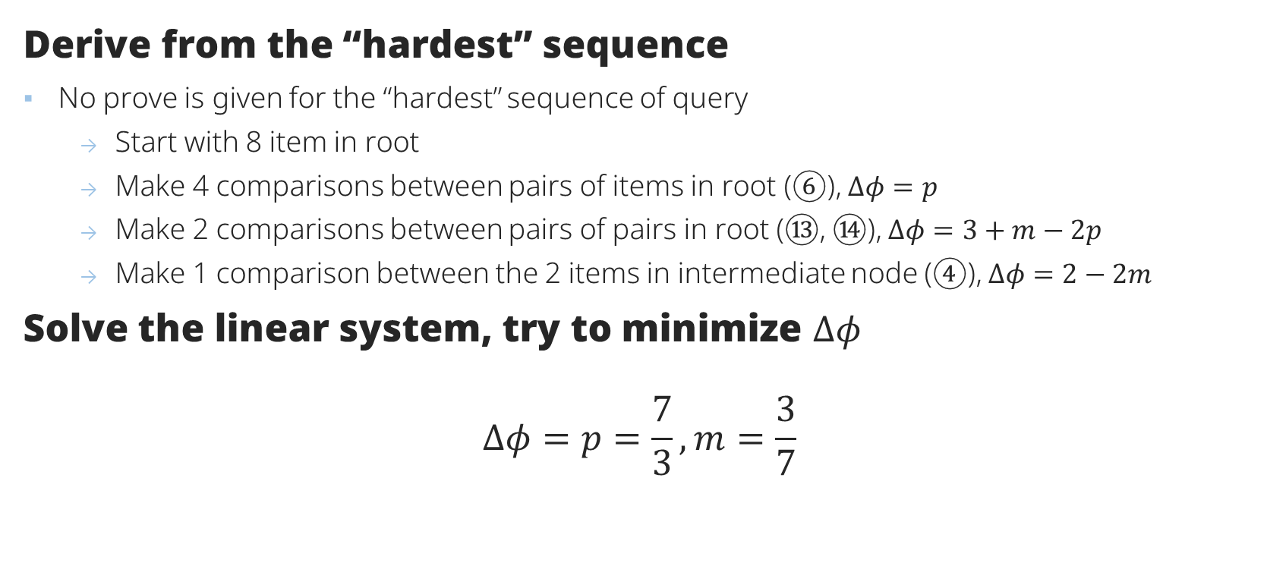

Deciding value for $m, p$
Derive from the “hardest” sequence
No prove is given for the “hardest” sequence of query
Start with 8 item in root
Make 4 comparisons between pairs of items in root (⑥), $Δφ=p$
Make 2 comparisons between pairs of pairs in root (⑬, ⑭), $Δφ=3+m−2p$
Make 1 comparison between the 2 items in intermediate node (④), $Δφ=2−2m$
Solve the linear system, try to minimize $Δφ$
$$Δφ=p=\frac{7}{3}, m=\frac{3}{7}$$
Using this adversary, we need at least $\frac{7}{8\log{3}} n\log{n} ≈0.5521 n \log{n}$ comparisons

Slide 39
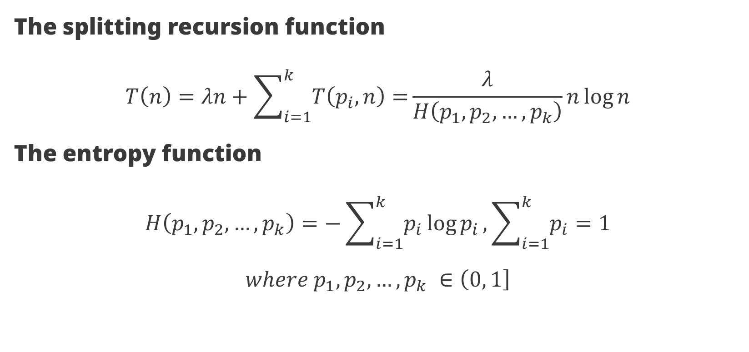
Number of Comparison With Recursion
The splitting recursion function
$$T\left(n\right)=λn+\sum_{i=1}^{k}{T\left(p_{i}, n\right)=}\frac{λ}{H\left(p_{1},p_{2},…, p_{k}\right)}n\log{n}$$
The entropy function
$$H\left(p_{1},p_{2},…, p_{k}\right)=−\sum_{i=1}^{k}{p_{i}\log{p_{i}}},\sum_{i=1}^{k}{p_{i}=1}$$
$$where p_{1},p_{2},…, p_{k} ∈\left(0, 1\right]$$

Slide 40


The Non-Balance Problem
We cannot balance 8 items in 7 comparisons
Ends with 2-3-3 distribution of items in children
Causing the lower bound is not being achievable
Thus, we symmetrically perform the algorithm again, in total using 16 items
Results in 5 – 6 – 5 distribution
Apply the recursion function
By balancing, we now can use this recursion function with parameter
$λ=\frac{7}{8},p_{1}=\frac{5}{16},p_{2}=\frac{6}{16},p_{3}=\frac{5}{16}$
$T\left(n\right)≈0.5540 n \log{n}$
4x2
2
8
2
2
2
3
3
Unbalanced distribution causes result not matching up the previous $0.5521 n\log{n}$

Slide 41


The Fix①
The weighted ternary tree
Each path from parent to child is assigned a weight $w_{1},w_{2},w_{3}$
The distribution of items, $a_{1},a_{2},a_{3}$, sums up to 1
We can define the minimum number of comparisons being:
$$T\left(n\right)=\min_{n_{1}+n_{2}+…+n_{k}=n}{\sum_{i=1}^{k}{\left(w_{i}n_{i}+T\left(n_{i}\right)\right)}}=\min_{a_{1}+a_{2}+…+a_{k}=1}{\sum_{i=1}^{k}{\left(w_{i}{a_{i}n}_{i}+T\left({a_{i}n}_{i}\right)\right)}}$$
$$=\min_{a_{1}+a_{2}+…+a_{k}=1}\left(\left\langle a, w\right\rangle n\sum_{i=1}^{k}{T\left({a_{i}n}_{i}\right)}\right)$$
$$T\left(n\right)=\min_{a}{\frac{\left\langle a, w\right\rangle }{H\left(a\right)} n\log{n}}$$

Slide 42

The Fix③
Find proper distribution $a$ and weight $w$
The solution minimizing $\min_{a}{\frac{\left\langle a, w\right\rangle }{H\left(a\right)} n\log{n}}$ must be symmetric
$a=\left(a, 1−2a, a\right), w=(w, 3−2w,w)$
We can then write $\frac{\left\langle a, w\right\rangle }{H\left(a\right)}=f(a, w)=\frac{2aw+(1−2a)(3−2w)}{−2a\log{a−\left(1−2a\right)\log\left(1−2a\right)}}=\frac{g\left(a, w\right)}{h\left(a, w\right)}$
To minimize $f\left(a, w\right)$, we try to find $a$ for $\frac{∂f(a, w)}{∂a}=\frac{\frac{∂g\left(a, w\right)}{∂a}h\left(a, w\right)−g\left(a, w\right)\frac{∂h\left(a, w\right)}{∂a}}{h{\left(a, w\right)}^{2}}=0$
Thus, we try to solve $\left(6w−6\right)\left(−2a\log{a}−\left(1−2a\right)\log\left(1−2a\right)\right)=\left(\left(6a−2\right)w+3−6a\right)\left(2\log\left(1−2a\right)−2\log{a}\right)$ and use the value of $a=\frac{5}{16}$ from the hardest sequence, getting $w≈1.055$

Slide 43


The Fix ④
Solve the linear system again for hardest sequence
The equations are slightly different, since the weighs from parent to child is different now
Start with 8 item in root
Make 4 comparisons between pairs of items in root (⑥), $Δφ=p$
Make 2 comparisons between pairs of pairs in root (⑬, ⑭), $Δφ=3+m−2p$
Make 1 comparison between the 2 items in intermediate node (④), $Δφ=w+(3−2w) −2m$
We now know $p≈1.135, m≈0.404$
By verifying all previous item moving scenarios, we obtain $∆φ=p≈1.135$
This is the setting for the previous formula $T\left(n\right)$ to be minimal
Ultimately, using the ternary adversary, we need at least $\frac{7/8}{H\left(5/{16}, 3/8, 5/{16}\right)}n\log{n}$ comparisons to sort!

Slide 44











Moving To Degree Four
Notations
Most are same with lower degree notation, expect the children
Interval length 3
$child_{\left[0, 2\right]}\left(v\left(x\right)\right)$ — The left first level intermediate node
$child_{\left[1, 3\right]}\left(v\left(x\right)\right)$ — The right first level intermediate node
Interval length 2
$child_{\left[0, 1\right]}(v\left(x\right))$ — The left second level intermediate node
$child_{\left[1, 2\right]}(v\left(x\right))$ — The middle second level intermediate node
$child_{\left[2, 3\right]}(v\left(x\right))$ — The right second level intermediate node
Interval length 1
$child_{0}\left(v\left(x\right)\right),child_{1}\left(v\left(x\right)\right),child_{2}\left(v\left(x\right)\right),child_{3}\left(v\left(x\right)\right)$ — The child nodes, also exists in $T$
$$v(x)$$
$$child_{[0, 2]}$$
$$child_{[1, 3]}$$
$$child_{[0, 1]}$$
$$child_{[1, 2]}$$
$$child_{[2, 3]}$$
$$child_{0}$$
$$child_{1}$$
$$child_{2}$$
$$child_{3}$$

Slide 45











The 4-ary Tree
Storing Items
Nodes in $T\bigcap{T^{′}}$ and intermediate node with length 3 maintains set $I$ and set $P$
Intermediate node with length 2 only maintains set $I$
Comparable Items
Let $w$ be the lowest common ancestor in $T$ of $\overline{v}\left(x\right),\overline{v}\left(y\right)$
Let $v\left(x\right)$ has an interval according to its position
We get $x<y$ if —
$v\left(x\right)=v\left(y\right)=w, \left(x, y\right)∈P(w)$
Intervals are disjoint, and interval of $x$ is to the left
$$[0, 3]$$
$$[0, 2]$$
$$[1, 3]$$
$$[0, 1]$$
$$[1, 2]$$
$$[2, 3]$$
$$[0, 0]$$
$$[1, 1]$$
$$[2, 2]$$
$$[3, 3]$$

Slide 46

Potential of 4-ary Adversary
Breaking down
The potential function, $Φ$, is defined as the sum of the following terms —
For all items $x$, the sum of depth of $\overline{v}\left(x\right)$
$m_{0}$ multiplied by number of items in intermediate node with interval length 3
$m_{1}$ multiplied by number of items in intermediate node with interval length 2
$p_{0}$ multiplied by number of pairs of paired items in tree nodes
$p_{1}$ multiplied by number of pairs of paired item in intermediate node with interval length 3
Again, we try to find optimal value for these constant using the hardest query sequence
This time, its able to distribute the items into the children evenly, no more hustle dealing with unbalance problem

Slide 47

Dealing With Incomparable Items (4-ary)①
$$ΔΦ=1−m_{1}$$
Compare A : B
B
A
A
B

Slide 48

Dealing With Incomparable Items (4-ary)②
$$ΔΦ=m_{1}−m_{0}$$
B
Compare A : B
B
A
A

Slide 49

Dealing With Incomparable Items (4-ary)③
$$ΔΦ=1−m_{0}$$
B
Compare A : B
A
A
B

Slide 50

Dealing With Incomparable Items (4-ary)④
$$ΔΦ=m_{0}$$
A
A
Compare A : B
B
B

Slide 51

Dealing With Incomparable Items (4-ary)⑤
$$ΔΦ=m_{1}$$
A
Compare A : B
A
B
B

Slide 52

Dealing With Incomparable Items (4-ary)⑥
$$ΔΦ=2−2m_{1}$$
Compare A : B
A
B
A
B

Slide 53
Dealing With Incomparable Items (4-ary)⑦
$$ΔΦ=1−m_{1}$$
Compare A : B
A
B
A
B

Slide 54
Dealing With Incomparable Items (4-ary)⑧
$$ΔΦ=1−m_{0}$$
B
Compare A : B
A
A
B

Slide 55
Dealing With Incomparable Items (4-ary)⑨
$$ΔΦ=m_{1}$$
A
Compare A : B
B
A
B

Slide 56

Dealing With Incomparable Items (4-ary)⑩
$$ΔΦ=p_{1}−m_{0}$$
B
A
B
Compare A : B
A

Slide 57

Dealing With Incomparable Items (4-ary)⑪
$$ΔΦ=2m_{1}−2m_{0}$$
A
B
Compare A : B
A
B

Slide 58

Dealing With Incomparable Items (4-ary)⑫
$$ΔΦ=p_{1}−2m_{0}$$
A
B
A
B
Compare A : B

Slide 59

Dealing With Incomparable Items (4-ary)⑬
$$ΔΦ=p_{0}−m_{0}$$
A
A
B
B
Compare A : B

Slide 60

Dealing With Incomparable Items (4-ary)⑭
$$ΔΦ=p_{0}$$
A
B
A
B
Compare A : B

Slide 61

Dealing With Incomparable Items (4-ary)⑮
$$ΔΦ=1+m_{1}−p_{1}$$
A
C
Compare A : B
C
B
A
B

Slide 62

Dealing With Incomparable Items (4-ary)⑯
$$ΔΦ=2−p_{1}$$
C
A
Compare A : B
B
C
A
B

Slide 63
Dealing With Incomparable Items (4-ary)⑰
$$ΔΦ=1+m_{1}−p_{1}$$
A
C
Compare A : B
C
B
A
B

Slide 64
Dealing With Incomparable Items (4-ary)⑱
$$ΔΦ=1+m_{1}−p_{1}$$
A
C
Compare A : B
B
B
C
A

Slide 65
Dealing With Incomparable Items (4-ary)⑲
$$ΔΦ=2−p_{1}$$
C
B
Compare A : B
A
C
A
B

Slide 66
Dealing With Incomparable Items (4-ary)⑳
$$ΔΦ=2−p_{1}$$
C
B
Compare A : B
A
B
A
C

Slide 67

Dealing With Incomparable Items (4-ary)㉑
$$ΔΦ=1+2m_{1}−p_{1}−m_{0}$$
C
B
A
Compare A : B
C
A
B

Slide 68
Dealing With Incomparable Items (4-ary)㉒
$$ΔΦ=1−m_{1}$$
C
B
C
B
Compare A : B
A
A

Slide 69
Dealing With Incomparable Items (4-ary)㉓
$$ΔΦ=1−m_{1}$$
B
C
B
C
Compare A : B
A
A

Slide 70
Dealing With Incomparable Items (4-ary)㉔
$$ΔΦ=1+m_{1}−p_{1}$$
A
C
B
A
Compare A : B
C
B

Slide 71
Dealing With Incomparable Items (4-ary)㉕
$$ΔΦ=1−m_{0}$$
A
B
C
B
C
Compare A : B
A

Slide 72

Dealing With Incomparable Items (4-ary)㉖
$$ΔΦ=3+m_{1}−2p_{1}$$
C
B
D
A
Compare A : B
C
D
A
B

Slide 73
Dealing With Incomparable Items (4-ary)㉗
$$ΔΦ=3+m_{1}−2p_{1}$$
A
C
D
B
Compare A : B
C
A
D
B

Slide 74
Dealing With Incomparable Items (4-ary)㉗
$$ΔΦ=3+m_{1}−2p_{1}$$
A
C
B
D
B
D
Compare A : B
C
A

Slide 75

Dealing With Incomparable Items (4-ary)㉘
$$ΔΦ=p_{1}−p_{0}$$
C
A
C
A
Compare A : B
B
B

Slide 76

Dealing With Incomparable Items (4-ary)㉙
$$ΔΦ=1+m_{0}−p_{0}$$
C
B
C
Compare A : B
A
A
B

Slide 77

Dealing With Incomparable Items (4-ary)㉚
$$ΔΦ=2m_{1}−p_{0}$$
C
B
Compare A : B
C
B
A
A

Slide 78

Dealing With Incomparable Items (4-ary)㉛
$$ΔΦ=2+m_{0}−p_{0}−m_{1}$$
C
B
C
Compare A : B
A
A
B

Slide 79
Dealing With Incomparable Items (4-ary)㉜
$$ΔΦ=1+m_{0}−p_{0}$$
A
C
C
Compare A : B
B
B
A

Slide 80
Dealing With Incomparable Items (4-ary)㉝
$$ΔΦ=2+m_{0}−p_{0}−m_{1}$$
C
B
C
Compare A : B
A
A
B

Slide 81

Dealing With Incomparable Items (4-ary)㉞
$$ΔΦ=1+m_{1}−p_{0}$$
C
B
A
C
Compare A : B
A
B

Slide 82

Dealing With Incomparable Items (4-ary)㉟
$$ΔΦ=3m_{1}−p_{0}−m_{0}$$
A
C
B
Compare A : B
A
B
C

Slide 83

Dealing With Incomparable Items (4-ary)㊱
$$ΔΦ=1+2m_{0}−p_{0}$$
A
C
B
C
A
Compare A : B
B

Slide 84
Dealing With Incomparable Items (4-ary)㊲
$$ΔΦ=1+m_{0}−p_{0}$$
A
C
C
B
D
B
D
Compare A : B
A

Slide 85
Dealing With Incomparable Items (4-ary)㊳
$$ΔΦ=1+m_{0}−p_{0}$$
A
C
C
D
B
D
B
Compare A : B
A

Slide 86
Dealing With Incomparable Items (4-ary)㊴
$$ΔΦ=1+m_{0}−p_{0}$$
A
C
C
D
B
D
B
Compare A : B
A

Slide 87

Dealing With Incomparable Items (4-ary)㊵
$$ΔΦ=1+{3m}_{1}−p_{0}−p_{1}$$
D
B
A
C
Compare A : B
D
B
C
A

Slide 88
Dealing With Incomparable Items (4-ary)㊶
$$ΔΦ=1+m_{1}−p_{0}$$
C
A
D
B
C
A
Compare A : B
D
B

Slide 89

Dealing With Incomparable Items (4-ary)㊷
$$ΔΦ=1+m_{0}+p_{1}−2p_{0}$$
A
C
B
D
C
B
D
Compare A : B
A

Slide 90
Dealing With Incomparable Items (4-ary)㊸
$$ΔΦ=1+m_{0}+p_{1}−2p_{0}$$
D
B
A
C
C
D
B
Compare A : B
A

Slide 91

Deciding Value For $m_{0},m_{1}, p_{0},p_{1}$ ①
Derive from the “hardest” sequence
Again, no prove is given for the “hardest” sequence of query, but assumption
Start with 32 item in root
Make 16 comparisons between pairs of items in root (⑭), $Δφ=p_{0}$
Make 8 comparisons between minimal items among pairs of pairs in root (㊷), $Δφ=1+m_{0}+p_{1}−2p_{0}$
Make 4 comparison between single items in intermediate node $[1, 3]$ (symmetric ⑫), $Δφ=p_{1}−2m_{0}$
Make 4 comparison between minimal items among pairs of pairs in node $\left[1, 3\right]$ (㉖), 2 comparison between maximal items among the pairs of pairs in node $[1, 3]$ (symmetric ㉖), $Δφ=3+m_{1}−2p_{1}$
Make 1 comparison between pairs of items in node $\left[1, 2\right]$ (middle ⑥), 2 comparison between pairs of items in node $[2, 3]$ (symmetric ⑥), $Δφ=2−2m_{1}$

Slide 92

Deciding Value For $m_{0},m_{1}, p_{0},p_{1}$ ②
Balancing
The sequence distributes items in child as 8 – 7 – 9 – 8 fashion
Then, do the entire sequence symmetrically
End with evenly distributed 64 items
Result
Solving the linear system of the previous 5 equations we get —
$$p_{0}=\frac{32}{37},m_{0}=\frac{9}{37}, p_{1}=\frac{50}{37}, m_{1}=\frac{21}{37}$$
Thus, the lower bound of number of comparisons using this method is
$$\frac{37}{32∙2}n\log{n}=0.578125 n\log{n}$$

Slide 93

Going Beyond
Binary, Ternary and 4-ary were good, how about more?
Using a $k$-ary tree adversary, we now have a general approach to calculate the lower-bound
Guess the hardest comparison sequence
Solving a set of linear equations to get parameters for potential function
Check the potential function on all other possible comparisons
Failure on $k≥5$
The check last step is found to be incorrect for the assumed hardest sequence
Already in $k=4$, siblings in same level already induces a general “pair”
Brute-forcing the hardest sequence is possible, but likely is not going to be general

Slide 94

Future Work
Generalization
Is there a natural way to generalize proposed technique for larger degrees?
Is this approach able to lead to a $\left(1−o\left(1\right)\right)n\log{n}$ lower bound?
Suspect lower bound
The proposed approach, if generalizable, can get until
$$\frac{1}{2H(\frac{1}{4},\frac{3}{4})} n\log{n}≈0.616311 n\log{n}$$
4 items with interval $[0, 1]$ could be partitioned into ordered buckets $\frac{1}{4}n$ and $\frac{3}{4}n$ size, inducing the above equation, evaluated from previous recursive function $T(n)$
Breaking the $0.616311$ barrier requires more complicated structure of the adversary

